Slide 1

Object oriented programming Module # 7
Dr. Friedman

Slide 2
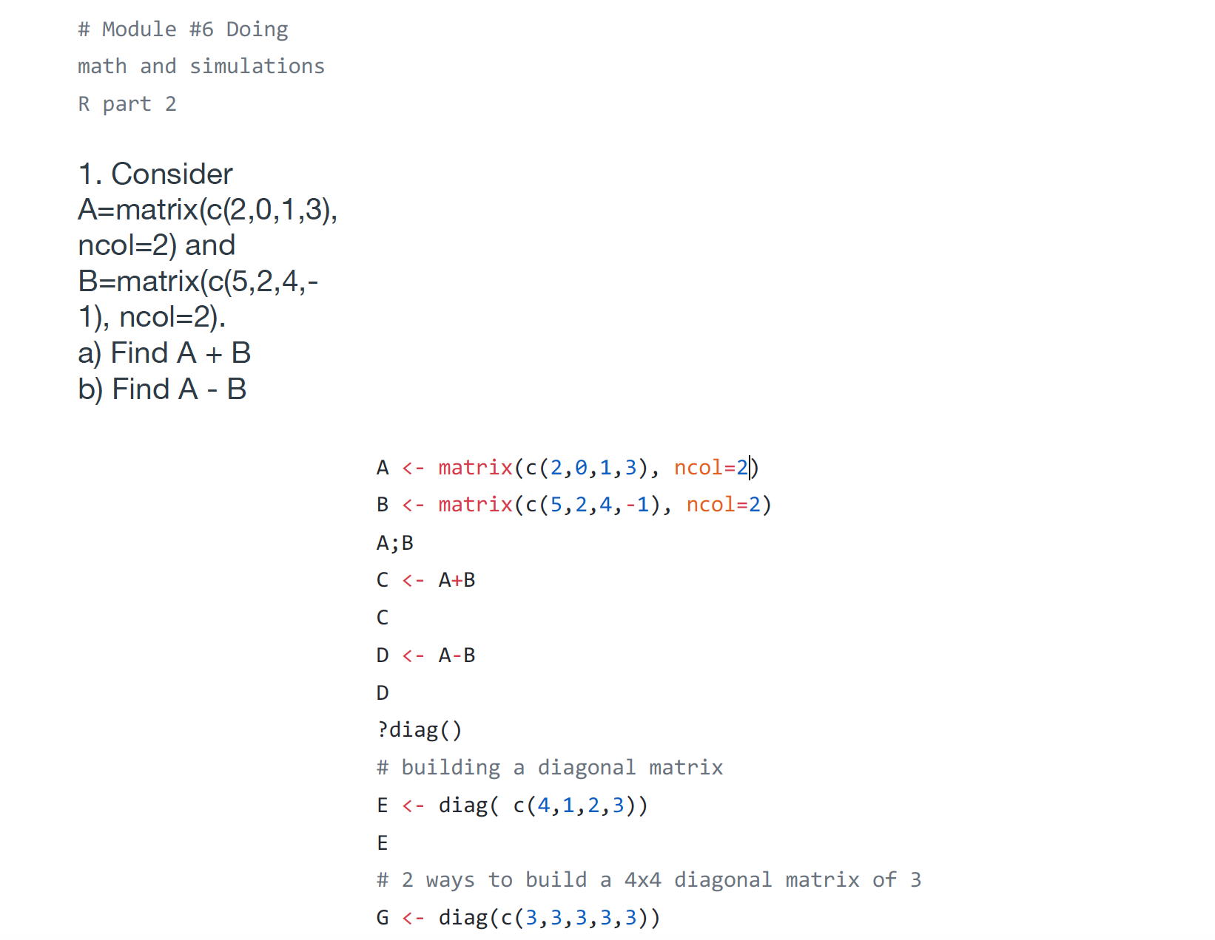
Review Module # 6 assignment

Slide 3
What is object-oriented programming (OOP)
Everything you touch in R – ranging from numbers to characters strings to matrices is an object, also known as OOP
R promotes encapsulation, which is packaging separate but related data items onto one class instance. It helps you keep track of related variables.
R classes are polymorphic, means that same function call leads to different operations for objects of a different classes.
R allows inheritance, which allows extending a given class to a more specialized class.

Slide 4
R Objects
R has a system for OOP, based on generic functions.
A class is a description of a thing (i.e., how objects of a certain type look like).
An object is an instance of a class.
A generic function is a function which dispatches methods. A generic function typically encapsulates a “generic" concept, such as plot, mean, logLik, residuals, predict, summary, and so on and so forth. The generic function does not actually do any computation.
A method is the implementation of a generic function for an object of a particular class.

Slide 5
R Objects
## R Objects..
# store data elements
# are members of different classes
# you can use different methods (functions) to operate on them
## Example objects
# variables, vectors, lists, arrays, matrices, data frames
## Common attributes of R objects
# class - defines type of object, what properties it possesses, how it behaves,
and how it relates to other types of objects
(numeric, character, logical, list, factor, matrix, dataframe, etc...)
# mode - storage mode or type of object (numeric, character, logical, list, function, etc...)
# typeof - typeof is an internal descriptor for R, similar to mode, although somewhat # more specific (See example below).
# method - a function associated with a particular type of object (ex. summary, print)
# Link to discussion on objects
http://cran.r-project.org/doc/manuals/r-release/R-lang.html#Introduction

Slide 6
R Objects
## Two types of R objects – S3 and S4
# S3 objects – classes and methods from beginning – informal methods
# S4 objects – classes and methods developed later – more formal methods (spatial)
## Object names..
# Case sensitive
# Consists of letters, numbers, and the dot or underline character
# Can not contain spaces or dashes '-' or special characters
# Can not start with a number or a dot followed by number
# Can not be a reserved word (stored R object).
## Testing object types and modes
myObject <- 1.2345 # Create object
isS4(myObject) # Test if object is S4 object
mode(myObject) # Get mode
typeof(myObject) # Get type
class(myObject) # Get class
is.character(myObject) # Test if object is character
is.vector(myObject) # Test if object is vector

Slide 7
R Objects
x1 x2 x3 x4 x5 x6
1 2 3 4 5 6 7 8
Z <-

Slide 8
R Objects
x1 x2 x3 x4 x5 x6
1 2 3 4 5 6 7 8
The MODE of Z is determined automatically by the types of things stored in Z – numbers, characters, etc. If it is a mix, mode = list.

Slide 9
R Objects
x1 x2 x3 x4 x5 x6
The CLASS of Z is either set by default depending, on how it was created, or is explicitly set by user. You can check the objects’ class and change it. It determines how functions deal with Z.
1 2 3 4 5 6 7 8

Slide 10
What is class and what are methods?
A class is an abstract definition of a concrete real world object
A method is a function that performs specific calculations on objects of a specific class.
Generic function is used to determine the class of its arguments and select the appropriate method. A generic function is a function with a collection of methods.

Slide 11
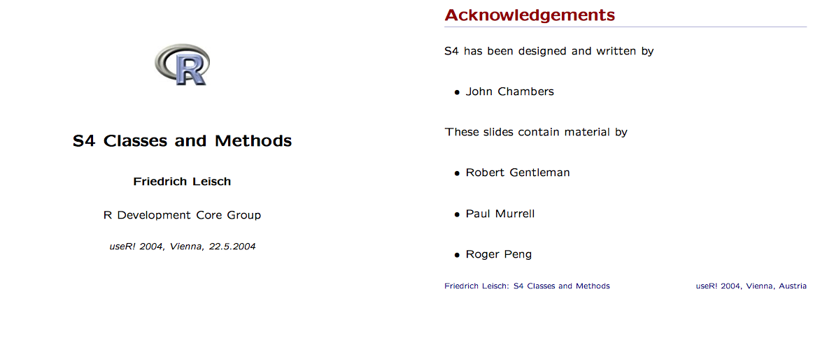
More information about Class vs. Methods under S4

Slide 12
Object Oriented Programming (OOP) in R
Class
Software abstraction of a real world object.
Reflects how we think of objects and what information they contain.
Defined in terms of slots.
An object is an instance of a class.
Defines the structure, inheritance, and initialization of objects.
Method
Function that performs an action on data (objects).
Defines how a particular function should behave depending on the class of its arguments.
Allows computations to be adapted to particular classes.
A generic function is a dispatcher.
J. M. Chambers (1998). Programming with Data.

Slide 13
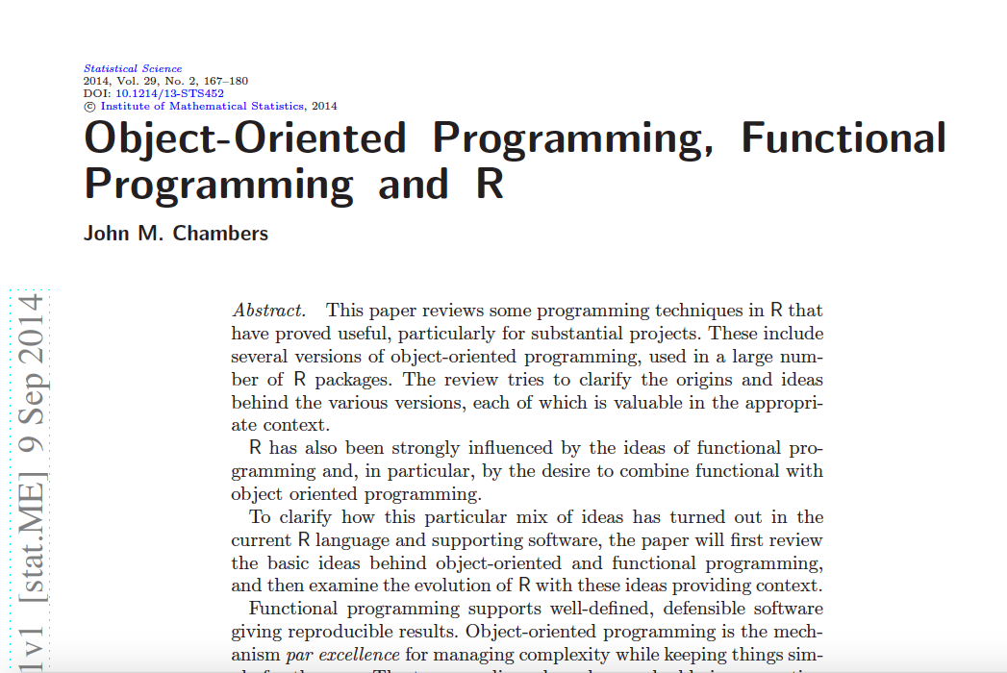
J. M. Chambers (1998). Programming with Data.

Slide 14
S3 vs. S4 systems in R
The S language (and R) has two object systems, known informally as S3 and S4, and each system can be used fairly independently of the other.
S3 objects, classes and methods have been available in R from the beginning. They are informal and very interactive.
S4 objects, classes and methods are much more formal and rigorous, but less interactive (Chambers, 1998), which is available through the methods package, attached by default since version 1.7.0.
Note, our textbook comments on the differences between S3 vs. S4 S3 – older, simpler, more dynamic, less structured version, single dispatch S4 – newer, more structured, more rigorous, multi-dispatch

Slide 15
S3 classes
Most common class used
Can be applied to multiple data types IE Plot() print() summary()
Can only dispatch on the first argument
Allows you to easily change the class of existing objects (Bad) Personal note: S3 class has no formal, predefined definition. Basically, a list with its class attribute set to some class name, is an S3 object. The components of the list become the member variables of the object. Following is a simple example of how an S3 object of class student can be created.

Slide 16
Example
> s <- list(name="John", age=21, GPA=3.5) > class(s) <- "student"> >s # Result $name [1] "John” $age [1] 21 $GPA [1] 3.5 attr(,"class") [1] "student"
Note: attr() function to set the class attribute of the object.

Slide 17
Using Constructors to Create Objects
It is a good practice to use a function with the same name as class (not a necessity) to create objects.
This will bring some uniformity in the creation of objects and make them look similar. We can also add some integrity check on the member attributes.

Slide 18
Using Constructors to Create Objects
>student = function(n,a,g) { if(g>4 || g< 0) stop("GPA must be between 0 and 4")
value = list(name = n, age = a, GPA = g)
attr(value,"class") = "student"
value
}

Slide 19
Example
> s <- student("Paul", 26, 3.7) >s $name [1] 26 $GPA [1] 3.7 attr(“class”) [1] “student” >class(s) [1] “student” > s <- student("Paul", 26, 5) Error in student("Paul", 26, 5) : GPA must be between 0 and 4 R will point on the Error in student("Paul", 26, 5) : GPA must be between 0 and 4 > s <- student("Paul", 26, 2.5) # it’s up to us to maintain it or not >$$GPA <-5

Slide 20
Writing Your Own Generic Function
Now this method will be created and called whenever we print() an object of class "student".
It is possible to make our own generic function like print() or plot().
> Print function (x, ...)
UseMethod("print")
<bytecode: 0x0674e230>
<environment: namespace:base> > plot
function (x, y, ...)
UseMethod("plot")
<bytecode: 0x04fe6574>
<environment: namespace:graphics>

Slide 21
UseMethod() function
We can see that they have a single call to UseMethod() with the name of the generic function passed to it. This is the dispatcher function which will handle all the background details. It is this simple to implement a generic function.
>student <- function(n,a,g) { if(g>4 || g<0) stop("GPA must be between 0 and 4")
value <- list(name=n, age=a, GPA=g) attr(value, "class") <- "student"
value
} > grade <- function(obj) {
UseMethod("grade")
}

Slide 22
S3
Operation | S3
Define Class | Implicit in constructor code
Create object | Build list, set class attr
Reference member variable | $
Implement generic f() | Define f.classname()
Declare generic | UseMethod()

Slide 23
Examples based on our textbook

Slide 24
S3 Creating
> j = list(name = “JOE”, salary=55000, union = T)
>class(j) = “employee”
>attrubutes(j) #check the class
>$names
[1] “name” “salary” “union”
>$class
[1] “employee”

Slide 25
S3 Creating Extended
One line creation foo <- structure(list(), class = "foo")

Slide 26
S3 Creating Extended
> j = list(name = “JOE”, salary=55000, union = T)
>class(j) = “employee”
>attrubutes(j) #check the class
>$names
[1] “name” “salary” “union”
>$class
[1] “employee”

Slide 27
S4 classes
Safer
More rigorous error checking
Can dispatch on multiple argument
Does not allow you to easily change the class of existing objects (Good)

Slide 28
S3 vs. S4
Operation | S3 | S4
Define Class | Implicit in constructor code | SetClass()
Create object | Build list, set class attr | New()
Reference member variable | $ | @
Implement generic f() | Define f.classname() | setMthod()
Declare generic | UseMethod() | SetGeneric()

Slide 29
Defining S4 class
S4 class is defined using the setClass() function. In R terminology, member variables are called slots. While defining a class, we need to set the name and the slots (along with class of the slot) it is going to have.
>setClass(“employee”, representation( name=“character”, salary=“numeric”, union=“logical” )

Slide 30
Creating S4 Objects
S4 objects are created using the new() function
> s <- new("student", name="John", age=21, GPA=3.5)
> s
Slot "name":
[1] "John"
Slot "age":
[1] 21
Slot "GPA":
[1] 3.5

Slide 31
More functions under S4
*We can check if an object is an S4 object through the function is S4(). > isS4(s)
[1] TRUE
* Another function is called setClass(). It returns a generator function. It can also be used to create new objects. This function acts as a constructor.
> student <- setClass("student", slots=list(name="character", age="numeric", GPA="numeric"))

Slide 32
Writing your own method
We will use setMethod() function plus implement our method for the show() generic function.
setMethod("show",
"student",
function(object) {
cat(object@name, "\n")
cat(object@age, "years old\n")
cat("GPA:", object@GPA, "\n")
}
)

Slide 33
More functions in S4: accessing and modifying
Just as components of a list are accessed using $, slot of an object are accessed using @.
>s <- new(“student”, name=“John”, age=21, GPA=3.5) > s@name
[1] "John”
> s@GPA
[1] 3.5
> s@age
[1] 21

Slide 34
Modification through reassignment
* A slot can be modified through reassignment. > s@GPA <- 3.7
> s
Slot "name":
[1] "John"
Slot "age":
[1] 21
Slot "GPA":
[1] 3.7

Slide 35
Slot() function
Similarly, slots can be access or modified using the slot() function. > slot(s,"name")
[1] "John”
> slot(s,"name") <- "Paul"
> s
Slot "name":
[1] "Paul"
Slot "age":
[1] 21
Slot "GPA":
[1] 3.7

Slide 36
Object Management for S3 and S4
> ls() Lists all your current objects
> rm() remove objects
> save() save objects (plural) that can be > load() later
> class() and mode() give more information of the structure of the object
> exists() returns true or false depending on the objects existance

Slide 37
Extended examples
Are on pages 207-230 The book has many examples that go into extended detail on both uses and creation.

Slide 38
Review
Create an S3 and S4 object
Test to confirm the object is correctly created
Integrate the given data
Create a function on the given data set
Call the manipulated data from the S3 and S4 Object.

Slide 39
Assignment goal and overview
Looking at comparing the creation and methods for S3 and S4 Objects
Create both an S3 and S4 object
Test object type using otype() in the Pryr package
Display the objects
Call a variable from within the s3 and s4 object using $ and @ respectively

Slide 40
Step one
Install package pryr which allows you to test object types
> install.packages(“pryr”)
> library(pryr)
> otype(######) Function from the pryr package that allows you to test an object. Will return the Object Type.

Slide 41
Create a method S3 example
isNA = function(eatsBreakfast=TRUE, myFavorite="ceral") { me = list(hasBreakfast = eatsBreakfast, favoriteBreakfast = myFavorite) ## Set the name for the class
class(me) = append(class(me), "North American") return(me) } This is a method that calls the creation of the s3 object.
See next slide for secondary example

Slide 42
Create a method S3 example
isNA = function(eatsBreakfast=TRUE, myFavorite="cereal") { me = list(hasBreakfast = eatsBreakfast, favoriteBreakfast = myFavorite) attr(me,"class") = "NorthAmerican“ me } You can also use the attr() method.

Slide 43
Creating the S3 Object and Test
> bubba = isNA() Creates the Object
> bubba Displays the contents > bubba$hasBreakfast Calls a variable inside the object > otype(bubba) Displays the object type
> fu = isNA(eatsBreakfast=TRUE, myFavorite = “fried eggs”) > fu > fu$myFavorite > otype(fu)

Slide 44
Create a S4 method example for Object and Test
> FirstQuadrant <- setClass("FirstQuadrant", slots = c(x = "numeric", y = "numeric"), prototype = list(x = 0.0, y = 0.0), validity = function(object){ if((object@x < 0) || (object@y < 0 )){ return("A negative was given")} else{return(TRUE)} } )
This is a method to create a S4 object. “validity” checks the values being given during object creation.

Slide 45
Create S4 Object and Test
> x = FirstQuadrant() Creates the S4 object > x Displays the object >otype(x) Shows the type of object. > y = FirstQuadrant(x = 5, y = 7) Creates another S4 object > y@x Calls values from that object > y@y > z = FirstQuadrant(x = 3, y = -2) (will return your error message) > z

Slide 46
Examples drawn from
http://www.cyclismo.org/tutorial/R/s3Classes.html
http://adv-r.had.co.nz/OO-essentials.html

